Slide 1

Intro to Python

Slide 2
Content

Slide 3
Installation
Windows
https://tutorialdeep.com/python/install-python-windows/
https://docs.conda.io/projects/conda/en/latest/user-guide/install/windows.html
Linux
https://docs.python-guide.org/starting/install3/linux/
https://docs.conda.io/projects/conda/en/latest/user-guide/install/linux.html
macOS
https://www.saintlad.com/install-python-3-on-mac/
https://docs.conda.io/projects/conda/en/latest/user-guide/install/macos.html

Slide 4
Creating a conda environment
Windows
open anaconda prompt
Linux / macOs
open terminal
All OS’
conda create --name workshop python=3.6
conda activate workshop
pip install matplotlib, pandas

Slide 5
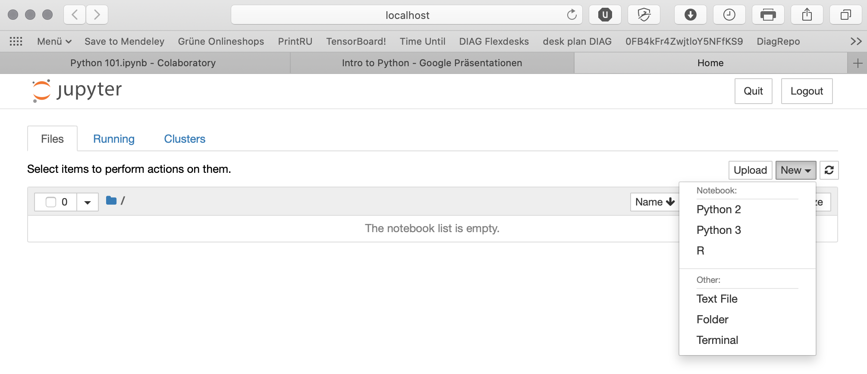
Starting a notebook
jupyter notebook
go to http://localhost:8888/tree

Slide 6
And now: hands on!

